Slide 1
Predicting Student Attendance and Analyzing Influential Factors at New York Public Schools
Ayan Karim

Slide 2
What is PASSNYC?
PASSNYC is a non profit organization that facilitates the provision of educational services to talented individuals at underserved schools in New York.
PASSNYC researches how to develop more paths for talented students to register in the SHSAT for placement in specialized schools.
PASSNYC and their partners develop outreach programs to under privileged schools to improve educational opportunity and increase placement in specialized schools.

Slide 3
Description of Data
The chosen data set consists of 161 columns of continuous information on demographics, school performance, attendance, truancy, academic proficiency scores and school income estimates.
PASSNYC derived an Economic Need Index that quantitatively rates schools on how much they need help.
The data set also includes categorical information on the city, district and address of the schools as well as school performance ratings.

Slide 4
Problem Statement
My objective is to use the PASSNYC data to build a regression model that predicts Student Attendance Rates and then to interpret the results to investigate what factors influence the attendance rate. Furthermore, I'll build a classification model to categorically identify schools that have have problems with attendance.

Slide 5
Implications of Model
This product is primarily developed for PASSNYC, who can use this information to target schools that need their attention, but it can be adapted by other organizations in New York involved in policy making for education, such as strategic planners on education boards.
PASSNYC can use this information to target with low attendance and make effort to increase school participation and hence increased registration in the SHSAT for placement in specialized schools.

Slide 6
Research Questions
1. What factors influence student attendance rate at a given school?
2. Using these factors as indicators, can we identify schools that are in danger of low participation in educational opportunities due to low attendance rates?

Slide 7
Success Metrics
Our Regression Model must accurately predict Student Attendance Rate with at least 85% accuracy with cross validation scores ranging at most a 3% difference.
Our Classification Model must accurately predict "Low Attendance" Schools at least 90% accuracy, with Type I and Type II errors below 6%.

Slide 8
Data Cleaning and Formatting
Problems with the data set included null values, unwanted symbols (such as dollar signs, percent and commas) object data that was meant to be numeric and empty columns.
Dropped all the rows with null values, converted all the percentage ratings to values between 0 and 1 and removed the currency symbols. All variables that were meant to be continuous were converted to numeric variables.
All rows where "Student Attendance Rate" is equal to 0 was removed because they were outliers.
Dummy variables on specific information like grade, demographic, test scores were removed because they were incomplete and slowed down the models’ performance.

Slide 9
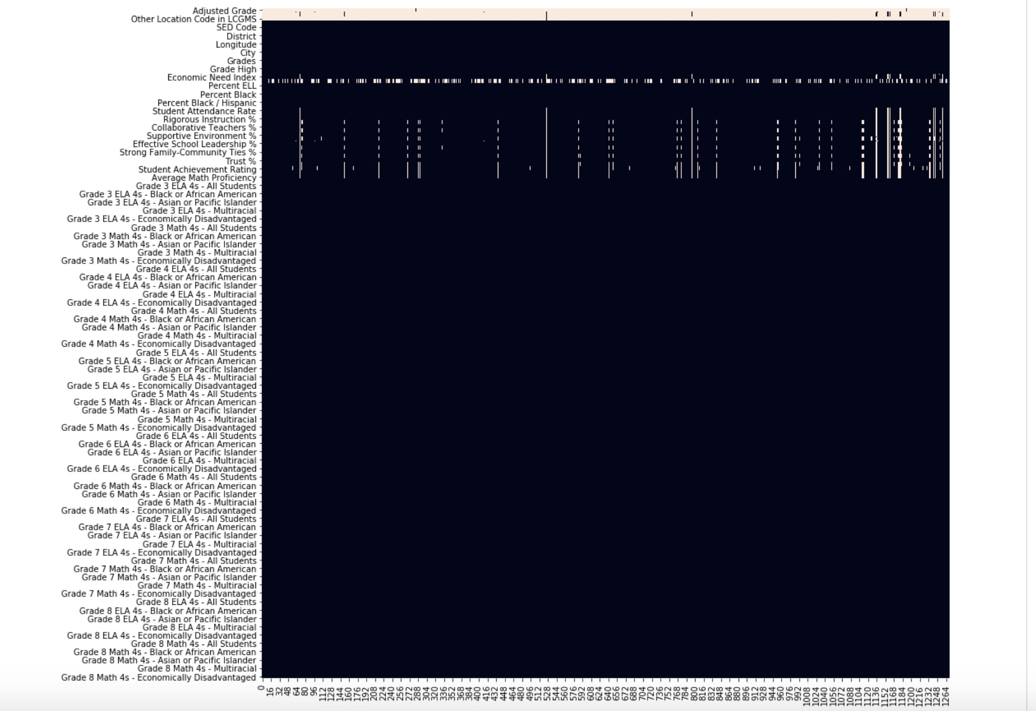

Slide 10
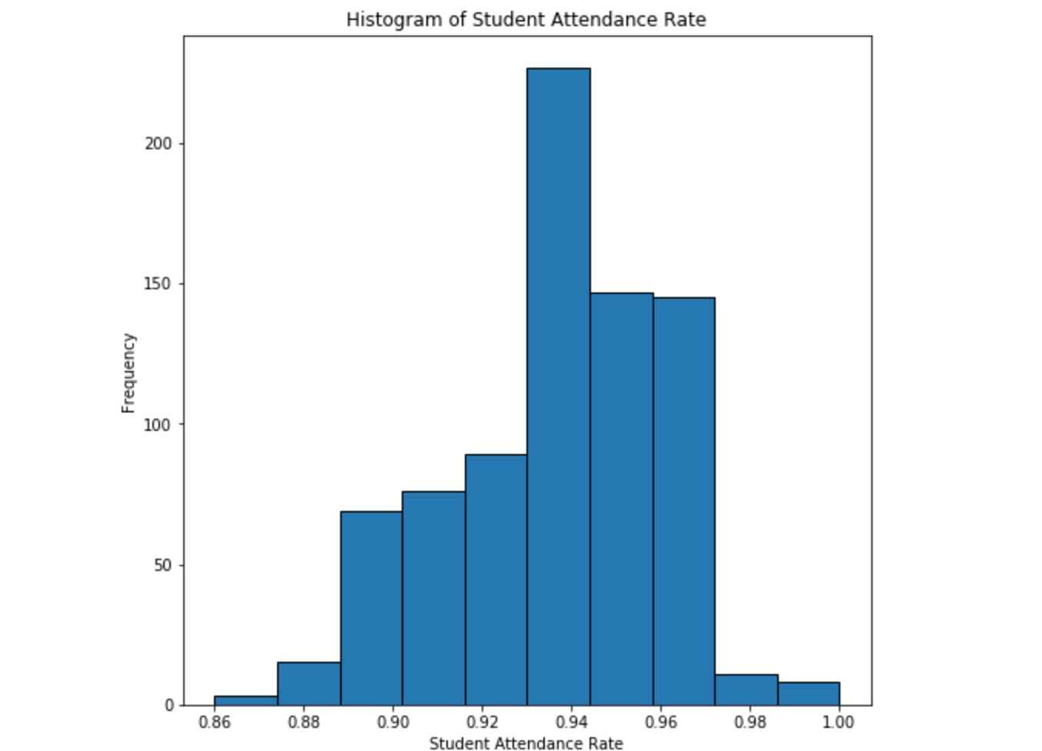
Target Variable: Student Attendance Rate

Slide 11
Feature Engineering and Selection Methodology
1. One-hot encoding for categorical variables.
2. Train baseline regression models on the feature data set we have available.
3. Rank the significance of each variable as an indicator in our model
4. Filter out irrelevant variables that compromises the efficiency of our model more so than actually improving.
5. Combine correlated features that'll improve the accuracy of our model and reduce overfitting.
6. Repeat this process iteratively until we can no longer improve the model. This should improve both the consistency of our model predictions and their accuracy.

Slide 12
Regression Parameters
Model trained on 80% of our data, then tested it on a sample of 20% of the data.
Evaluate consistency of our scores by applying cross validation methods that split the sample into 5 holdout groups. We'll repeat this process for all our predictive models that we'll employ, so that we can observe both the predictive power and consistency of the models.

Slide 13
Ordinary Least Squares Regression Model
OLS baseline prediction scores very highly on this data set at 89.17% on our test set which satisfies our success metric of at least 85%. But its cross validation scores range between 87% and 95%, which is an 8% difference.
Reducing features in our model based on importance, we've improved the accuracy of the model on our test set to 90.49% .
Minimum accuracy score on our holdout-groups in the cross validation is 91% and maximum is 96% with a total difference range of 4% between hold-out groups.

Slide 14
Gradient Boosted Regression Model
Baseline predictive power on the test set is high at 88.17% and the cross validation scores range between 87% and 95%.
After feature selection, the accuracy score on the test set is 89.64% (compared to 90.48% in OLS)
Cross validation scores are far more consistent as it ranges between 91.29% and 92.22%.

Slide 15
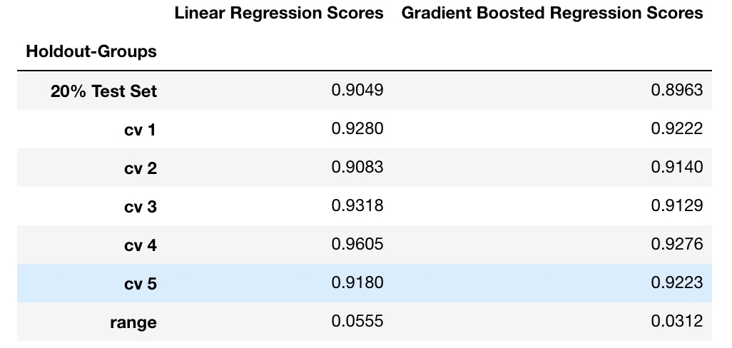
Conclusions on Regression Models
Gradient Boosted Ensemble model is the more reliable model for use on future data sets. This model has a combination of both high predictive power and consistent cross-validation scores that meet our success metrics of at least 85% predictive accuracy and 3% variance in cross validation.

Slide 16
Interpretations of Features in Regression Models
OLS Regression Model
Demographic
Economic Need Index
Support system and educational quality
Select cities tend to have more of an impact on student attendance than others
Percent of Students Chronically Absent"
Gradient Boosted Regression Model
Language and math proficiency
(Other important features same as in OLS Model)

Slide 17
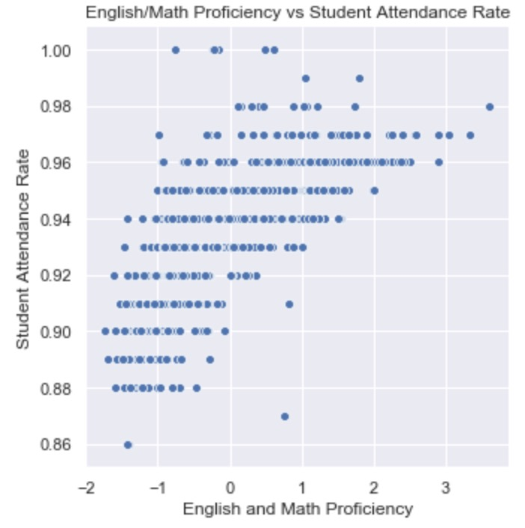
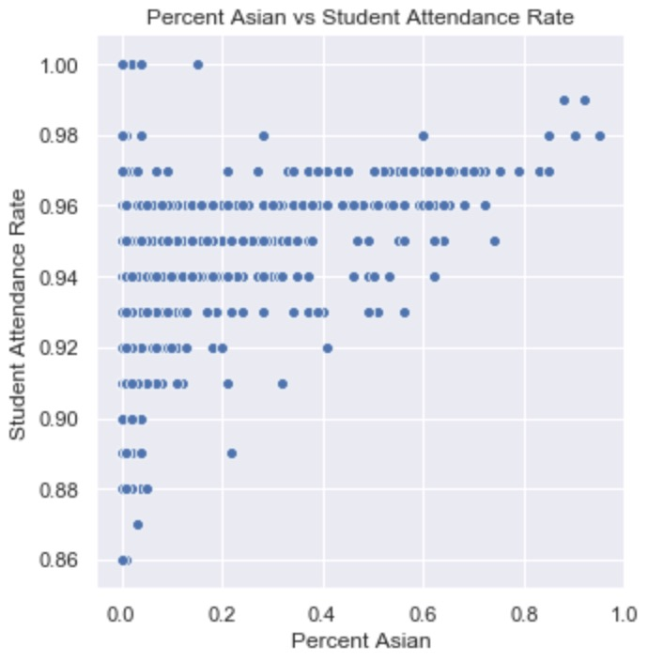
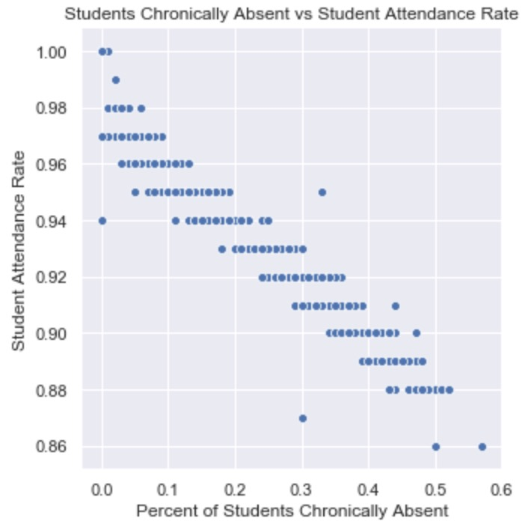

Slide 18
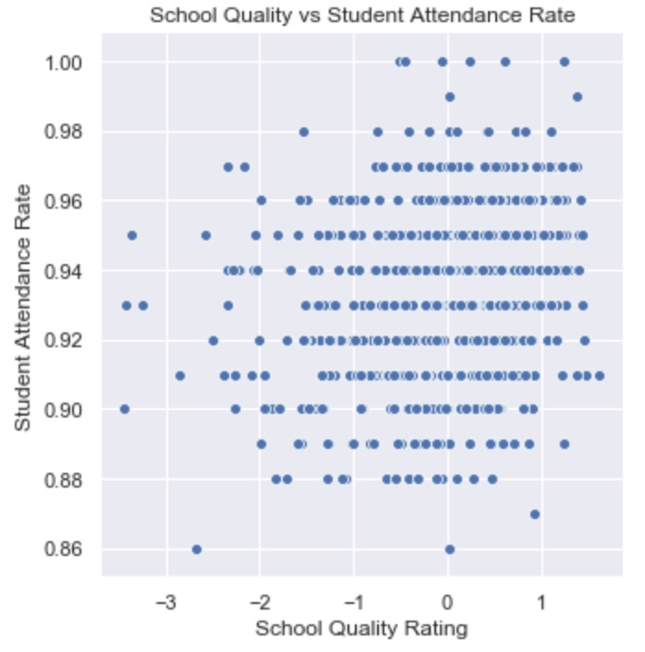

Slide 19
Although our regression model gives us an accurate insight on the attendance rate, we aren't actually sure if that attendance rate is bad or good and whether PASSNYC should be concerned or not.

Slide 20
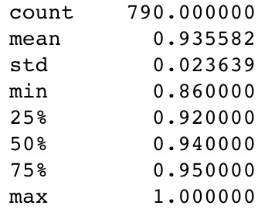
Baseline Classifier Models
The range of "Student Attendance Rate" is quite small between 0.86 and 1.00, since a majority of students tend to go to school.
Define a bad attendance rate as any rate less than the median (0.94) and we'll use a binary indicator to identify schools that have a bad attendance rate.

Slide 21
Gradient Boosted Classifier Model
The Weak Learners model has extremely high predictive power at 98.10%.
0% Type I error as our model correctly identifies all cases in which attendance rate is "good" (is 1) and 4.6% Type II error indicating that it incorrectly predicts that a school has a "good" attendance rate is only 4.6% of the time.

Slide 22
Random Forest Classifier Model
Slightly worse performance than our weak learners model on our test set at 96.8%.
Type I error of 1.07% and a Type II error of 6.15%, which is slightly worse than the weak learners model.

Slide 23
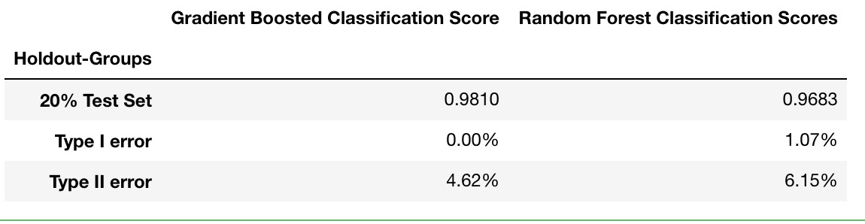
Conclusions of Classification Models
Based on the prediction scores of these two models, the Gradient Boosted Classifier seems to a better model to use. It satisfies our success metric with 98% accuracy and minimizes both type I and type II errors relative to the Random Forest model.

Slide 24
Important Factors related to Attendance Rate
School income
Longitude and latitude
Demographic
Economic Need Index
Support system and educational quality
Select cities tend to have more of an impact on student attendance than others
Percent of Students Chronically Absent"
Language and math proficiency

Slide 25
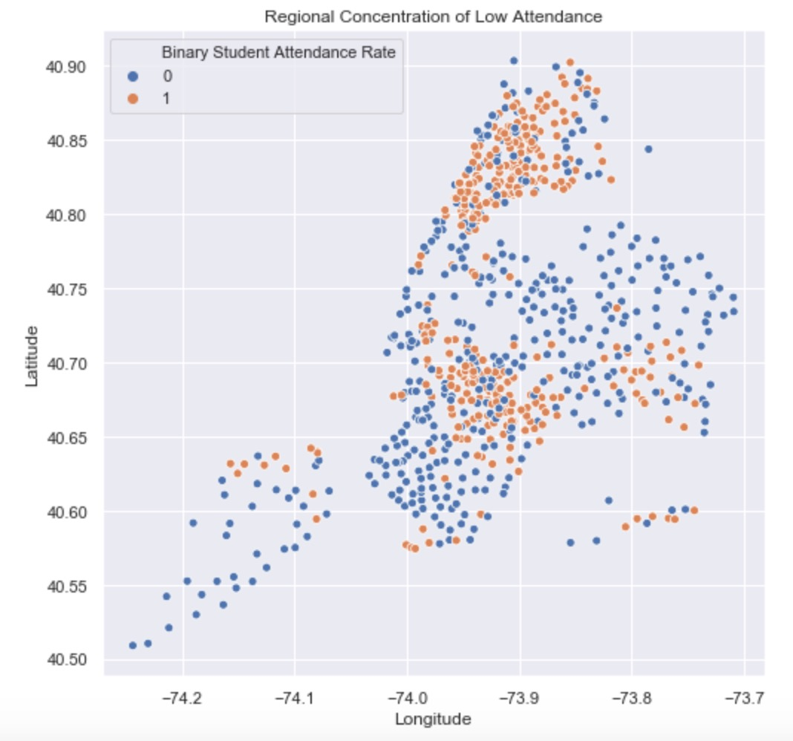

Slide 26
Biases and Weaknesses
I purposefully dropped over 100 columns of dummy variables that had extremely specific information on grade, demographic, certain test scores, etc.
Final Data set consisted of 790 rows of information. This isn't a very large data set.
Many of our predictor variables are districts, and cities. This makes our model very specific to New York. Thus it isn't a reliable model for other states.
Many of these variables look like their from surveys so there might be lots of bias in the questionnaires such as misreporting. These variables include "Supportive School Environment %" and "Trust %". It's not clear how PASSNYC described this data quantitatively and how they rated it. Furthermore, the variable is a bit obscure as we don't know how they defined an ambiguous term like "Trust".
The Economic Need Index variable is a black box rating system that PASSNYC derived to rate how much a given school needs external support.
We observe a few outliers in the distribution and scatterplot of the residual errors of the OLS model that require further investigation. However, overall the errors had a normal distribution and homogenous variance so the model seems reliable.
Type II errors
No cross-validation in Weak Learners classifier

Slide 27
Improvements and Recommendations for Further Research
In the future, we can improve data collection techniques when collecting specific information on a schools grade, demographic and test scores by ensuring that the information is completely filled out. At an administrative level schools can require the documentation of such information for research purposes. We could also ignore that information altogether, since the time and effort of collecting that information isn't worth the benefits.
Collect more information of school quality, income, community economic and health information, etc. which can be quantitatively interpretable in any region in the United States to make our model more reliable across the country. However the city and district specific information is also very important when considering specific regions or states, because problems vary from state to state and it would be bad to rely on a "one-color-fits-all" model.
Access to meta-data on methodology, term definitions, economic need index calculation and survey techniques.

Slide 28
References
https://www.kaggle.com/passnyc/data-science-for-good

